Slide 1

Artificial Intelligence

Slide 2
Lecture # 09
Knowledge Based Agent

Slide 3
Today’s Lecture
A knowledge-based agent
The Wumpus World
Syntax , semantics
What is logic?

Slide 4
A knowledge-based agent
A knowledge-based agent includes a knowledge base and an inference system.
A knowledge base is a set of representations of facts of the world.
Each individual representation is called a sentence.
The sentences are expressed in a knowledge representation language.
The agent operates as follows:
1. It TELLs the knowledge base what it perceives.
2. It ASKs the knowledge base what action it should perform.
3. It performs the chosen action.

Slide 5
Knowledge - Based (KB) Agents
The Agent must be able to do:
Represents states and actions
Incorporates new percepts
Update internal representation of the world
Deduce hidden properties of the world
Deduce appropriates action
Domain independent algorithm
Inference Engine
Knowledge Based
Domain specific content

Slide 6
Architecture of a knowledge-based agent
Knowledge Level.
The most abstract level: describe agent by saying what it knows.
Example: A taxi agent might know that the Golden Gate Bridge connects San Francisco with the Marin County.
Logical Level.
The level at which the knowledge is encoded into sentences.
Example: Links(GoldenGateBridge, SanFrancisco, MarinCounty).
Implementation Level.
The physical representation of the sentences in the logical level.
Example: ‘(links goldengatebridge sanfrancisco marincounty)

Slide 7
The Wumpus World environment
The Wumpus computer game.
The agent explores a cave consisting of rooms connected by passageways.
Looking somewhere in the cave is the Wumpus, a beast that eats any agent that enters its room.
Some rooms contain bottomless pits that trap any agent that wanders into the room.
Occasionally, there is a heap of gold in a room.
The goal is to collect the gold and exit the world without being eaten.

Slide 8
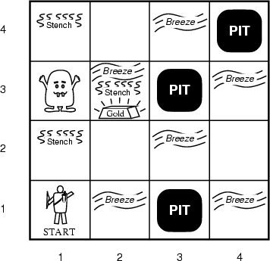
A typical Wumpus world
The agent always starts in the field [1,1].
The task of the agent is to find the gold, return to the field [1,1] and climb out of the cave.

Slide 9
Agent in a Wumpus world: Percepts
The agent perceives
a stench in the square containing the wumpus and in the adjacent squares (not diagonally)
a breeze in the squares adjacent to a pit
a glitter in the square where the gold is
a bump, if it walks into a wall
a woeful scream everywhere in the cave, if the wumpus is killed
The percepts will be given as a five-symbol list: If there is a stench, and a breeze, but no glitter, no bump, and no scream, the percept is
[Stench, Breeze, None, None, None]
The agent can not perceive its own location.

Slide 10
Wumpus actions
go forward
turn right 90 degrees
turn left 90 degrees
grab means pick up an object that is in the same square as the agent
shoot means fire an arrow in a straight line in the direction the agent is looking. The arrow continues until it either hits and kills the wumpus or hits the wall. The agent has only one arrow. Only the first shot has any effect.
climb is used to leave the cave. Only effective in start field.
die, if the agent enters a square with a pit or a live wumpus. (No take-backs!)

Slide 11
Wumpus goal
The agent’s goal is to find the gold and bring it back to the start as quickly as possible, without getting killed.
1000 points reward for climbing out of the cave with the gold
1 point deducted for every action taken
10000 points penalty for getting killed

Slide 12
Wumpus world characterization
Fully Observable No – only local perception
Deterministic No – cannot plan strategy in the beginning.
Episodic No – sequential at the level of actions
Static Yes – Wumpus and Pits do not move
Discrete Yes
Single-agent? Yes – Wumpus is essentially a natural feature

Slide 13
A typical Wumpus world
The agent always starts in the field [1,1].
The task of the agent is to find the gold, return to the field [1,1] and climb out of the cave.

Slide 14
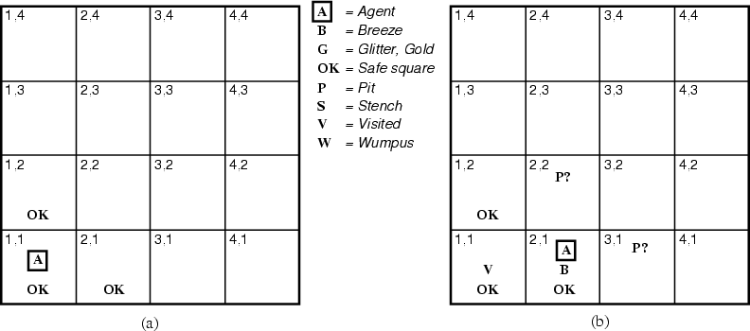
The Wumpus agent’s first step

Slide 15
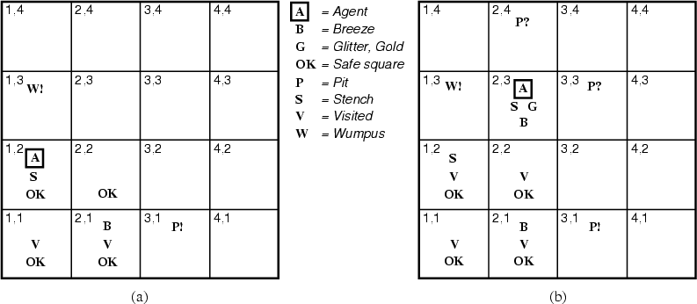
Later

Slide 16
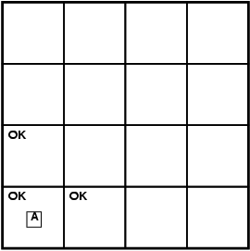
Exploring a wumpus world
A agent
B breeze
G glitter
OK safe cell
P pit
S stench
W wumpus

Slide 17
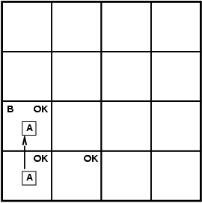
Exploring a wumpus world
A agent
B breeze
G glitter
OK safe cell
P pit
S stench
W wumpus

Slide 18
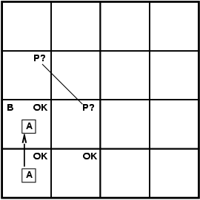
Exploring a wumpus world
A agent
B breeze
G glitter
OK safe cell
P pit
S stench
W wumpus

Slide 19
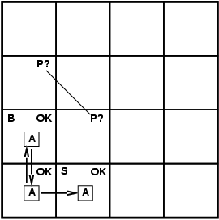
Exploring a wumpus world
A agent
B breeze
G glitter
OK safe cell
P pit
S stench
W wumpus

Slide 20
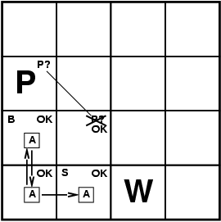
Exploring a wumpus world
A agent
B breeze
G glitter
OK safe cell
P pit
S stench
W wumpus

Slide 21

Exploring a wumpus world
A agent
B breeze
G glitter
OK safe cell
P pit
S stench
W wumpus

Slide 22
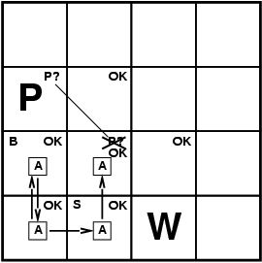
Exploring a wumpus world
A agent
B breeze
G glitter
OK safe cell
P pit
S stench
W wumpus

Slide 23
Representing Knowledge
The agent that solves the wumpus world can most effectively be implemented by a knowledge-based approach.
Need to represent states and actions, update internal representations, deduce hidden properties and appropriate actions.
Need a formal representation for the KB
And a way to reason about that representation.

Slide 24
Representation, reasoning, and logic
The object of knowledge representation is to express knowledge in a computer-tractable form, so that agents can perform well.
A knowledge representation language is defined by:
its syntax, which defines all possible sequences of symbols that constitute sentences of the language.
Examples: Sentences in a book, bit patterns in computer memory.
its semantics, which determines the facts in the world to which the sentences refer.
Each sentence makes a claim about the world.
An agent is said to believe a sentence about the world.

Slide 25
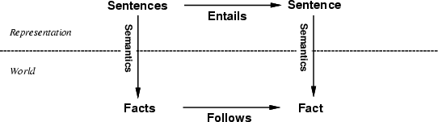
The connection between sentences and facts
Semantics maps sentences in logic to facts in the world.
The property of one fact following from another is mirrored
by the property of one sentence being entailed by another.

Slide 26
Entailment
Entailment means that one thing follows from another:
KB ╞ α
Knowledge base KB entails sentence α if and only if α is true in all worlds where KB is true
E.g., x+y = 4 entails 4 = x+y
Entailment is a relationship between sentences (i.e., syntax) that is based on semantics
A relationship between two sentences such that if the
First is true, the second must also be true, as if:
Her son drives her to work every day and Her son knows
how to drive .

Slide 27
Entailment and Proof
To clarify the difference between entailment and proof:
Entailment: if we have a set of formulae which are true, then as a logical consequence of this, some particular formula must also be true.
Proof: a formula is provable (derivable) in some logical system if there are rules of inference that allow the formula to be derived by performing some operations on the formulae.
Entailment is concerned with the semantics of formulae, proof is concerned with syntax only.

Slide 28
summary
Knowledge based agents apply inference to a knowledge base to derive new information and make decisions
Basic concepts of logic
syntax: formal structure of sentences
semantics: truth of sentences w.r.t. models
Entailment: necessary truth of one sentence given another
Inference: deriving sentences from other sentences

Slide 29
Logic as a KR language
Multi-valued
Logic
Modal
Temporal
Non-monotonic
Logic
Higher Order
Probabilistic
Logic
First Order
Propositional Logic
Fuzzy
Logic

